Slide 1
Edge NodeJS
NodeJS Integration with Edge

Slide 2
NodeJS* runtime
NodeJS runtime on Edge is Trireme
http://github.com/apigee/trireme
*Node.js is a trademark of Joyent, Inc. and is used with its permission. We are not endorsed by or affiliated with Joyent.
Notes:
Understanding of Node.js runtime (Trireme) becomes very important when designing/architecting a Node.js project that will be running on Edge

Slide 3
What is Trireme
Edge open-source project
Set of libraries for running node.js scripts inside JVM
Specifically designed to be embeddable within any Java program
“HTTP Adapter” lets it run inside existing containers
“Sandbox” restricts file and network I/O access

Slide 4
Why?
We wanted to add node.js capabilities to our existing product which is already built using Java
We wanted to use Java code from node.js
We didn’t want to assemble a node.js PaaS
We wanted script isolation – there is no way for one script to affect the heap of others
We wanted sandboxed execution
Prevent script from gaining access to file system and local network
Limit execution time of a script – preventing infinite loops

Slide 5
NodeJS implementation
Node.js = JavaScript shell + native modules in C++
Trireme exposes Java modules that mimic the interfaces of the C++ native modules in node.js.

Slide 6
Architecture
One thread per Node.js application
Async I/O handled via NIO within that thread
Additional thread pool for blocking operations
File I/O
DNS lookups
Replace native code from Node.js with Java alternatives
Internal modules such as “tcp_wrap”, etc.
Implement a few popular native modules with Java code
“iconv”, “node_xslt”, etc.

Slide 7
Why would you care
It is an open-source project that can be utilized outside Edge
If you want to embed Node.js apps inside existing Java application
If you want to run Node.js apps that take advantage of Java libraries you can’t live without, e.g. JDBC, XML parsers, XSLT engines
As it is the Node.js runtime used, it has significant impact on design and architecture of your solution that you need to know about
Node.js 0.10 is supported
Uses Rhino (JavaScript implementation for JVM) which only implements JavaScript 1.8
Newer features of V8, particularly the primitive array types, are not supported in Rhino
Trireme does not support 100% Node.js APIs

Slide 8
NodeJS vs. Trireme
NodeJS
Single-threaded event engine
Non-blocking TCP I/O
Non-blocking UDP datagrams
Non-blocking File I/O
Timers
“Buffer” object
Module loading system
Utility modules
Third-party components
V8 JavaScript engine
OpenSSL
ZLib
Trireme
Single-threaded event engine
Non-blocking TCP I/O
Non-blocking UDP datagrams
Non-blocking File I/O
Timers
“Buffer” object
Module loading system
Utility modules
Third-party components
Rhino JavaScript engine
Java SE
Bouncy Castle (crypto, optional)
Notes:
Comparison of implementation between “standard” node.js and Trireme

Slide 9
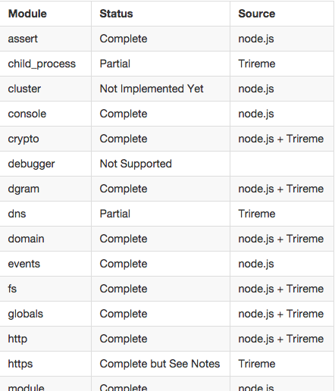
Compatibility
Can’t load native code (can’t load C code)
https://github.com/apigee/trireme#how-complete-is-trireme
Notes:
Understanding of Node.js runtime (Trireme) becomes very important when designing/architecting a Node.js project that will be running on Apigee Edge

Slide 10
Edge restrictions
Script to write files or to read outside of the current local directory tree where it was deployed
Script to listen on an incoming port (but it can open outgoing ports all it wants)
child_process
cluster
debugger
dgram
readline
repl
tty
Notes:
Apigee places certain restrictions on various operations, processes and protocols to be executed on Edge platform. These are mostly for security purposes.

Slide 11
NodeJS as a Target Endpoint
Target Endpoint
NodeJS
<HTTPTargetConnection>
<Properties>
<Property name="success.codes">2XX,3XX,4XX</Property>
</Properties>
<LoadBalancer>
<Algorithm>RoundRobin</Algorithm>
<Server name="server1"/>
<Server name="server2"/>
</LoadBalancer>
<Path>/resource</Path>
</HTTPTargetConnection>
<ScriptTarget>
<Properties>
<Property name="success.codes">2XX,3XX,4XX</Property>
</Properties>
<ResourceURL>node://app.js</ResourceURL>
</ScriptTarget>
Notes:
Comparison of implementation between “standard” node.js and Trireme

Slide 12
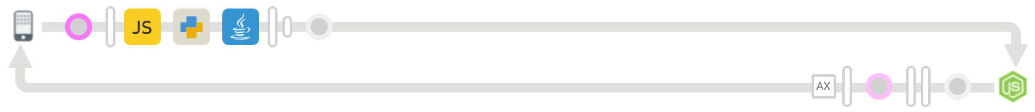
NodeJS as a Target Endpoint
Other languages are extension policies and placed on the flow as a step
Java
JavaScript
Python
Node.js implemented as a target not as a policy
JavaScript
Python
Java
NodeJS
Notes:
Compare Apigee Node.js implementation (i.e. it being a target) to other platforms supported (i.e. as a step)
Briefly mention the differences between steps and targets in Apigee Edge

Slide 13
NodeJS as a Target Endpoint
<TargetEndpoint name="node">
<Description>Node Target</Description>
<ScriptTarget>
<Properties>
<Property name="success.codes">2XX,3XX,4XX</Property>
</Properties>
<EnvironmentVariables>
<!-- process.env.var -->
<EnvironmentVariable name="var">VALUE</EnvironmentVariable>
</EnvironmentVariables>
<Arguments>
<Argument>argument</Argument>
</Arguments>
<ResourceURL>node://app.js</ResourceURL>
</ScriptTarget>
</TargetEndpoint>
<ProxyEndpoint>
…
<RouteRule name="node">
<TargetEndpoint>node</TargetEndpoint>
</RouteRule>
</ProxyEndpoint>
Notes:
This is the way to define a route to Node.js script
In Node.js target definition, you can specify environment variables and command line arguments to the script

Slide 14
NodeJS as a Target Endpoint
<ProxyEndpoint>
…
<RouteRule name="node">
<Condition>proxy.pathsuffix MatchesPath “/queue”</Condition>
<TargetEndpoint>node</TargetEndpoint>
</RouteRule>
<RouteRule name="directToBackend">
<TargetEndpoint>backend</TargetEndpoint>
</RouteRule>
</ProxyEndpoint>
NodeJS
Backend
Notes:
You can define multiple routes within the proxy definition and conditionally route traffic to either routes (you can’t route traffic to more than 1 target for the same request)

Slide 15
Apigee Access
apigee-access open source Node.js module
Provides Node.js applications running on the Edge platform a way to access Edge specific functionality. You can use this module to:
Access and modify "flow variables" within the Edge message context.
Retrieve sensitive data from the the secure store.
Use the built-in distributed cache.
Use the built-in distributed quota service.
Use the OAuth service.
http://apigee.com/docs/api-services/content/using-apigee-access
https://github.com/apigee/apigee-access
Notes:
Apigee places certain restrictions on various operations, processes and protocols to be executed on Edge platform. These are mostly for security purposes.

Slide 16
When to use NodeJS?
Try out of the box policies first
Configuration over code, aka policy over code
Speed / Agility
Let’s implement a distributed quota
Use an Edge policy implement from scratch
Quality
“Developed/Tested” once, “configured” everywhere
Maintained centrally
<Quota name="Quota.DailyPerApp">
<Interval>1</Interval>
<TimeUnit>day</TimeUnit>
<Distributed>true</Distributed>
<Synchronous>true</Synchronous>
<Identifier ref="request.queryparam.apikey" />
<Allow count="100" />
</Quota>

Slide 17
When to use NodeJS?
Then consider callout policies
Simple functionality which can be visualized as a step?
Get/set variable
Make custom/simple modifications to request/response?
Request/response data validations?
Edge supports Java, JavaScript, Python as callout policies
//offset parameter validation
var offset = context.getVariable('request.queryparam.offset');
if (offset != null) {
if (offset < 1) {
context.setVariable('errorCode', '400.02.001');
context.setVariable('errorMessage', 'offset query parameter value is invalid');
}
}

Slide 18
When to use NodeJS?
Non-http backend
Async execution
Complex mashups
Job scheduling
Bulk operations
Retry logic
Mockups
User interface
Quick demonstrations
PoC development
Consider Node.js if
Edge doesn’t have an existing policy to do the work
You need intelligent asynchronous processing logic
Implementation can be visualized as an API proxy target, rather than as a step
Legacy backend protocols (non HTTP)

Slide 19
When to use NodeJS?
Non-HTTP backend
POSTGRES
USERGRID
ZOOKEEPER
Edge
NodeJS
RABBITMQ
SMTP
.
.
.
WORLD OF NPM

Slide 20
When to use NodeJS?
Async operations
TARGET A
TARGET B
Edge
NodeJS

Slide 21
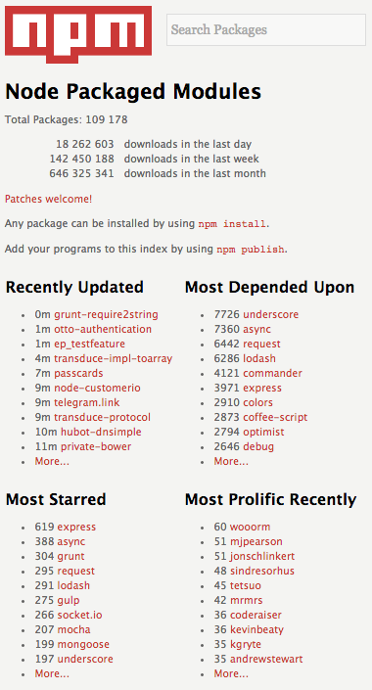
When to use NodeJS?
Module reuse
Notes:
There is a module already written for the functionality that you want to implement

Slide 22
When to use NodeJS?
Module reuse - async example
async.waterfall([
function(callback){
callback(null, 'one', 'two');
},
function(arg1, arg2, callback){
// arg1 now equals 'one' and arg2 now equals 'two'
callback(null, 'three');
},
function(arg1, callback){
// arg1 now equals 'three'
callback(null, 'done');
}
], function (err, result) {
// result now equals 'done'
});
async.parallel([
function(callback){
setTimeout(function(){
callback(null, 'one');
}, 200);
},
function(callback){
setTimeout(function(){
callback(null, 'two');
}, 100);
}
],
// optional callback
function(err, results){
// the results array will equal ['one','two'] even though
// the second function had a shorter timeout.
});
Notes:
async module

Slide 23
When NOT to use NodeJS?
There are existing Edge policies that can do the job
Cannot be visualized as an API proxy “target”
Node.js is implemented as a target, so
You cannot execute an Edge policy in the middle of your Node.js script
You cannot execute full Node.js script multiple times

Slide 24
Testing NodeJS
Testing Node.js applications
Grunt.js
Mocha
Chai
TDD
Notes:
Grunt, Mocha, Chai – TDD
TDD == Test Driven Development
http://code.tutsplus.com/tutorials/testing-in-nodejs--net-35018
TDD reduces development time and time to market
Increases accuracy

Slide 25
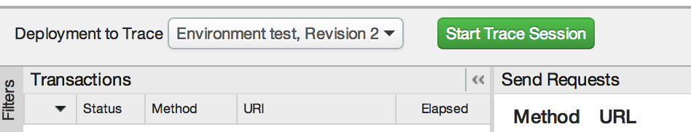
Troubleshooting NodeJS
Troubleshooting Node.js using the Edge Trace tool { hands on }
Inspecting requests, responses, and HTTP status codes
console.log()

Slide 26
Troubleshooting NodeJS
Handling dependencies and dependency conflicts
Express 3.7 and Connect 3.0 (deprecation notices and removal of middleware)
Conflicting module versions in Edge
Handling response errors and node script failures/crashes
Error handling in JavaScript (try/catch)
Syntax errors in Node.js
nodejitsu forever
Notes:
Grunt, Mocha, Chai – TDD
TDD == Test Driven Development
http://code.tutsplus.com/tutorials/testing-in-nodejs--net-35018
TDD reduces development time and time to market
Increases accuracy

Slide 27
Troubleshooting NodeJS
The node-inspector tool
Browser-based Node.js debugger
Navigate in your source files
Set breakpoints (and specify trigger conditions)
Step over, step in, step out, resume (continue)
Inspect scopes, variables, object properties
IntelliJ IDEA
A feature-rich GUI builder for Node.js
(Should be) free with the community edition
Notes:
Grunt, Mocha, Chai – TDD
TDD == Test Driven Development
http://code.tutsplus.com/tutorials/testing-in-nodejs--net-35018
TDD reduces development time and time to market
Increases accuracy

Slide 28
Troubleshooting NodeJS
Getting help
StackOverflow has an incredible wealth of Node.js knowledge
How to ask: http://stackoverflow.com/help/how-to-ask
Edge docs
http://apigee.com/docs/api-services/content/getting-started-nodejs-apigee-edge
Notes:
Grunt, Mocha, Chai – TDD
TDD == Test Driven Development
http://code.tutsplus.com/tutorials/testing-in-nodejs--net-35018
TDD reduces development time and time to market
Increases accuracy

Slide 29
THANK YOU

